Slide 1


Artificial Intelligence (Machine Learning & Deep Learning)
NAVTTC & Strings Technologies
by Salman Ahmad

Slide 2
Outline Week 8 Day 4&5
Gated Recurrent Unit Networks
Learning from Sequences over Time

Slide 3
What is GRU?

Slide 4
Why is GRU?

Slide 5
What is GRU?
GRU = Gated Recurrent Unit
A type of recurrent neural network that improves memory control like LSTM
Introduced in 2014 by Cho et al.
Combines memory gating with a simpler design than LSTM

Slide 6
Why GRU?
Solves vanishing gradient and long-term dependency problems
Similar to LSTM, but with fewer parameters
Trains faster and is easier to tune
Often performs just as well as LSTM, especially on smaller datasets

Slide 7
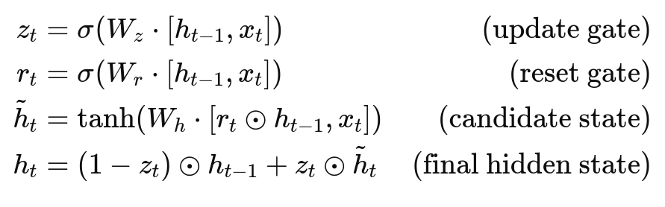
GRU Internal Mechanics
A GRU has two gates:
Update Gate z_{t}​: controls how much of the past to keep
Reset Gate r_{t}​: controls how much of the past to forget

Slide 8
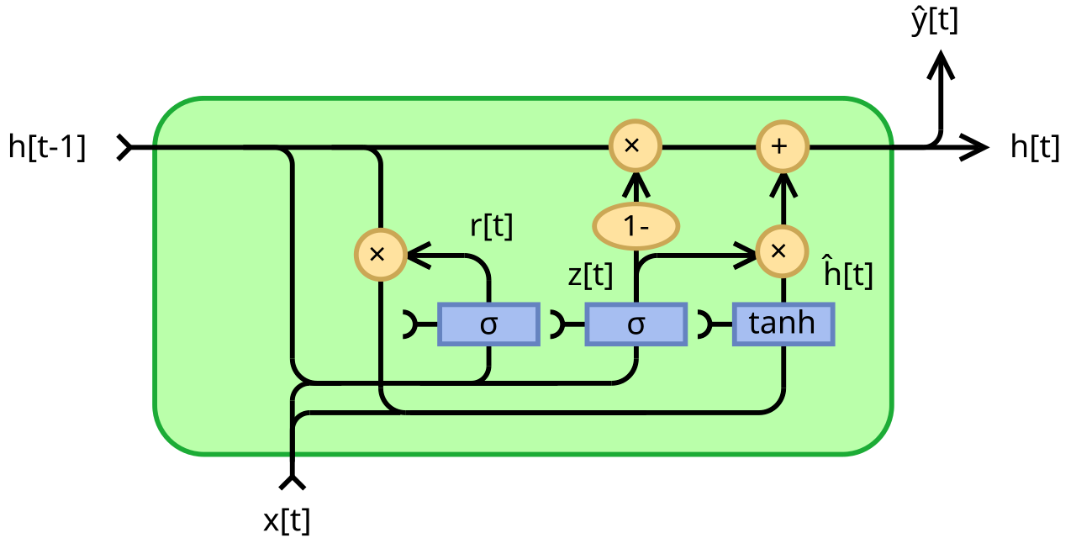
GRU – Fully gated

Slide 9
What Do These Gates Do?
Update gate z_{t}​:
Balances between keeping the old state vs. updating to the new
Reset gate r_{t}​:
Decides how much past info to "reset" when computing new candidate state
Less complex than LSTM: no separate cell state C_{t}, only h_{t}

Slide 10
How GRU Solves RNN Problems
Problem in RNN | GRU Solution
Vanishing gradients | Uses gates to regulate flow of info
No long-term memory | Maintains hidden state adaptively
Hard to train on sequences | Efficient gating & fewer parameters

Slide 11
GRU vs LSTM
Feature | LSTM | GRU
Gates | 3 (input, forget, output) | 2 (update, reset)
Separate cell state? | Yes (C_{t}) | No (only h_{t})
Parameter count | Higher | Lower
Training time | Slower | Faster
Performance | Strong (esp. for long tasks) | Comparable (or better?)
Which one is better? GRU or LSTM?
https://arxiv.org/pdf/1412.3555

Slide 12
GRU in TF/Keras
from tensorflow.keras.models import Sequential
from tensorflow.keras.layers import Embedding, GRU, Dense
model = Sequential([
Embedding(input_dim=10000, output_dim=64),
GRU(units=64, return_sequences=False),
Dense(1, activation='sigmoid')
])
return_sequences=False: returns only last output
Use return_sequences=True when passing to another RNN layer

Slide 13
Sequence Models
Sequence models are a type of machine learning model designed to handle data where the order or sequence of elements is crucial for understanding and prediction.
Type | Input | Output | Example
1 → 1 | Single value | Single value | Image classification
1 → Many | Single value | Sequence | Image captioning
Many → 1 | Sequence | Single value | Sentiment classification
Many → Many | Sequence | Sequence | Translation, POS tagging

Slide 14
Summary
GRUs are efficient, memory-capable RNNs
Fewer gates than LSTM → simpler + faster
Solves vanishing gradients and can learn temporal dependencies
Ideal for text, time series, and real-time systems

Slide 15

Questions?
"He who asks a question is a fool for a minute; he who does not remains a fool forever." – Confucius

